Slide 1

Location Location Location
Money Money Money

Slide 2

Ames Realtor
How to maximise the sale price of your house

Slide 3
01
Introduction
What do we do
02
Insights from our model
How to sell your house at a higher price
03
Recommendations
What should you do today

Slide 4
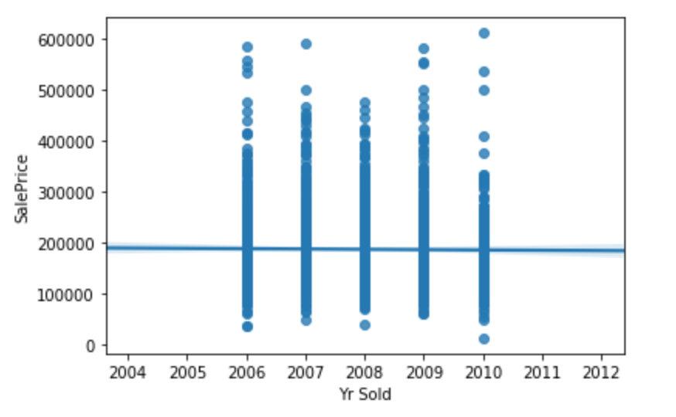
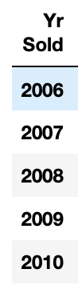
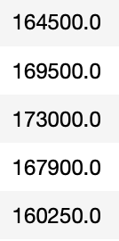
Introduction
Analyzed historical housing sales data in Ames, Iowa
2,051 transactions between 2006 and 2010
Median Sale Price
Prices range from $12,789 to $611,657 (mean at $168,000)
25 neighbourhoods

Slide 5
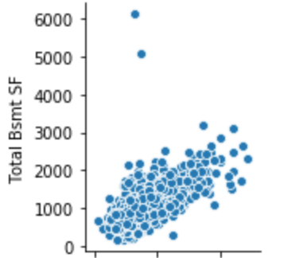
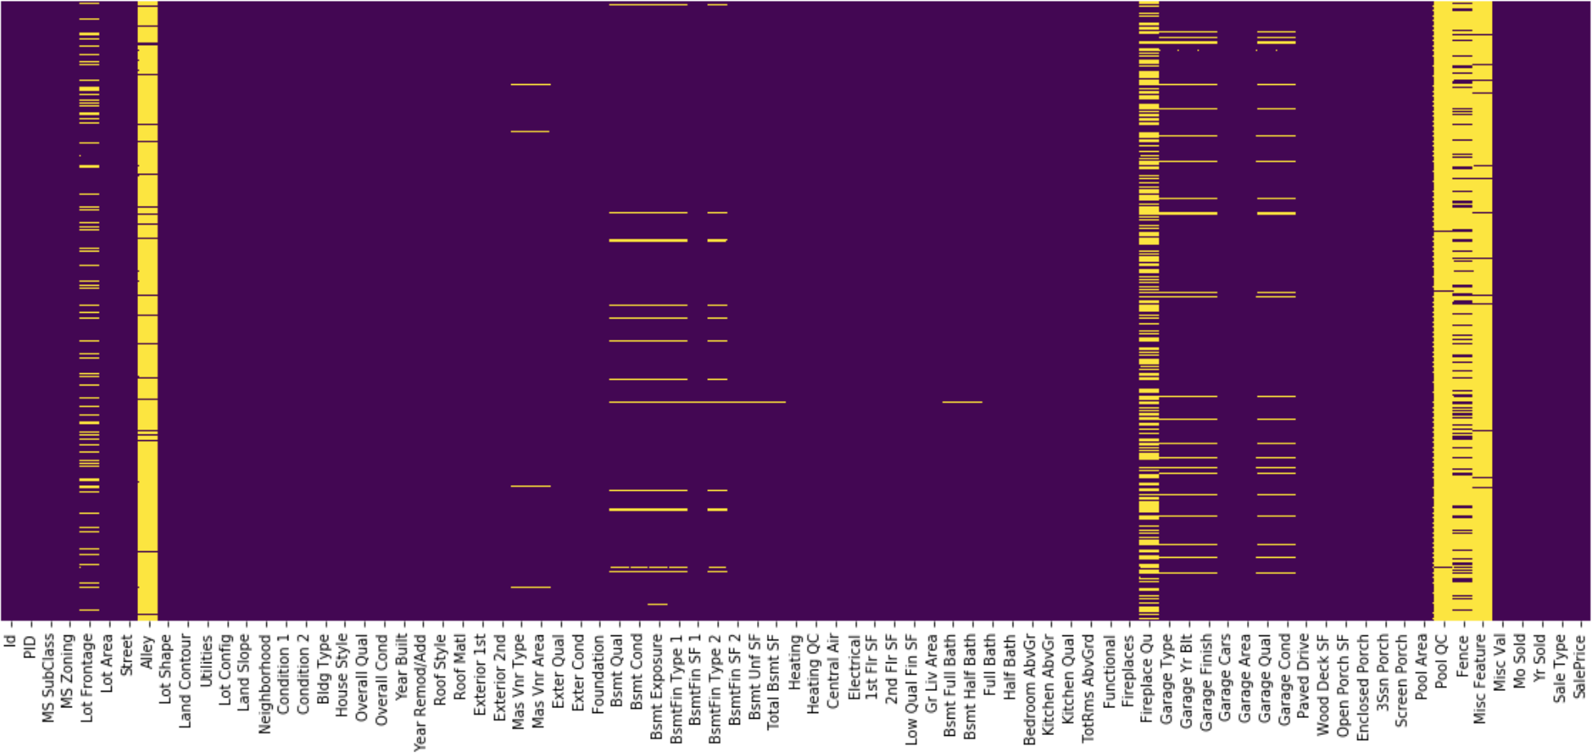
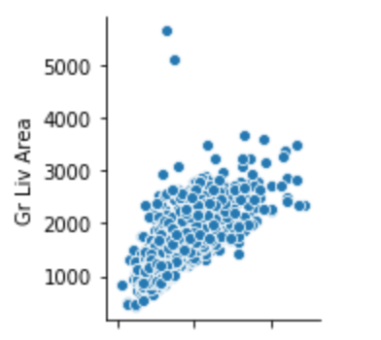
Data Processing
Null Values
Outliers
Removed the following outliers:
Lot Frontage >=300
Lot Area >= 100000
Mass Vnr Area >= 1500
BsmtFin SF 1 >=4000
BsmtFin SF 2 >= 1250
Total Bsmt SF >= 5000
1st Flr SF >= 3000
Low Qual Fin SF >= 600
Gr Liv Area >= 5000
Garage Yr Blt >= 2050
Wood Deck SF >= 1250
Columns with > 80% null values were not considered.
Categorical variables assumed none e.g. Null values in Fireplace Qu column replaced with ‘NA’.
Others were imputed 0.
Total Bsmt SF: Total square feet of basement area
Gr Liv Area: Above grade (ground) living area square feet

Slide 6
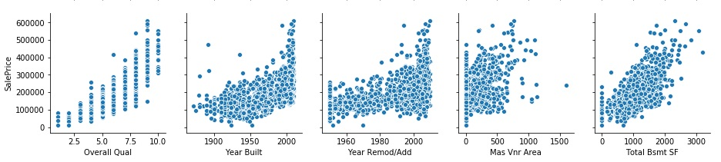
Data Processing
Pairplots helped to visualise linear correlation while heatmaps quantified correlation with sale price and amongst variables.
Design Metrics
Shortlist variables with > 50% correlation
Drop variables highly correlated with each other
Qualitative variables were considered using trial and error methods

Slide 7
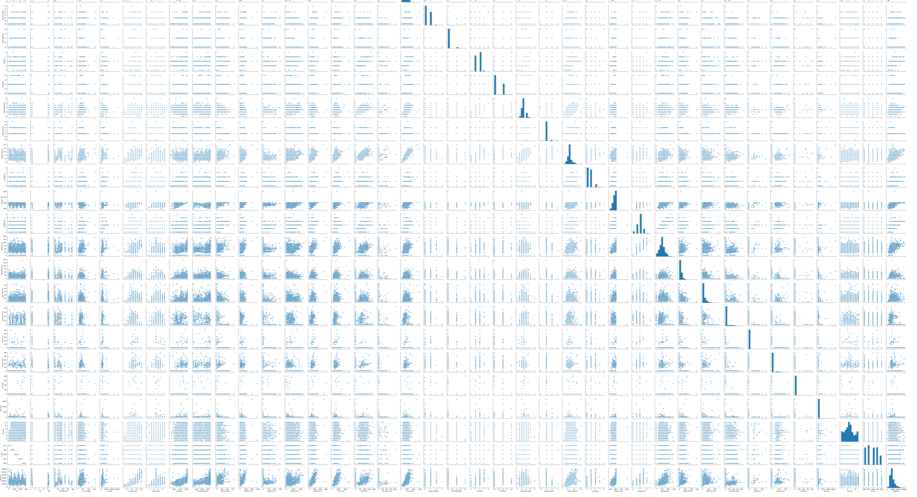

Sale Prices Prediction Model
We created a model that is able to predict prices with 92% accuracy

Slide 8
Insights from
our model

Slide 9
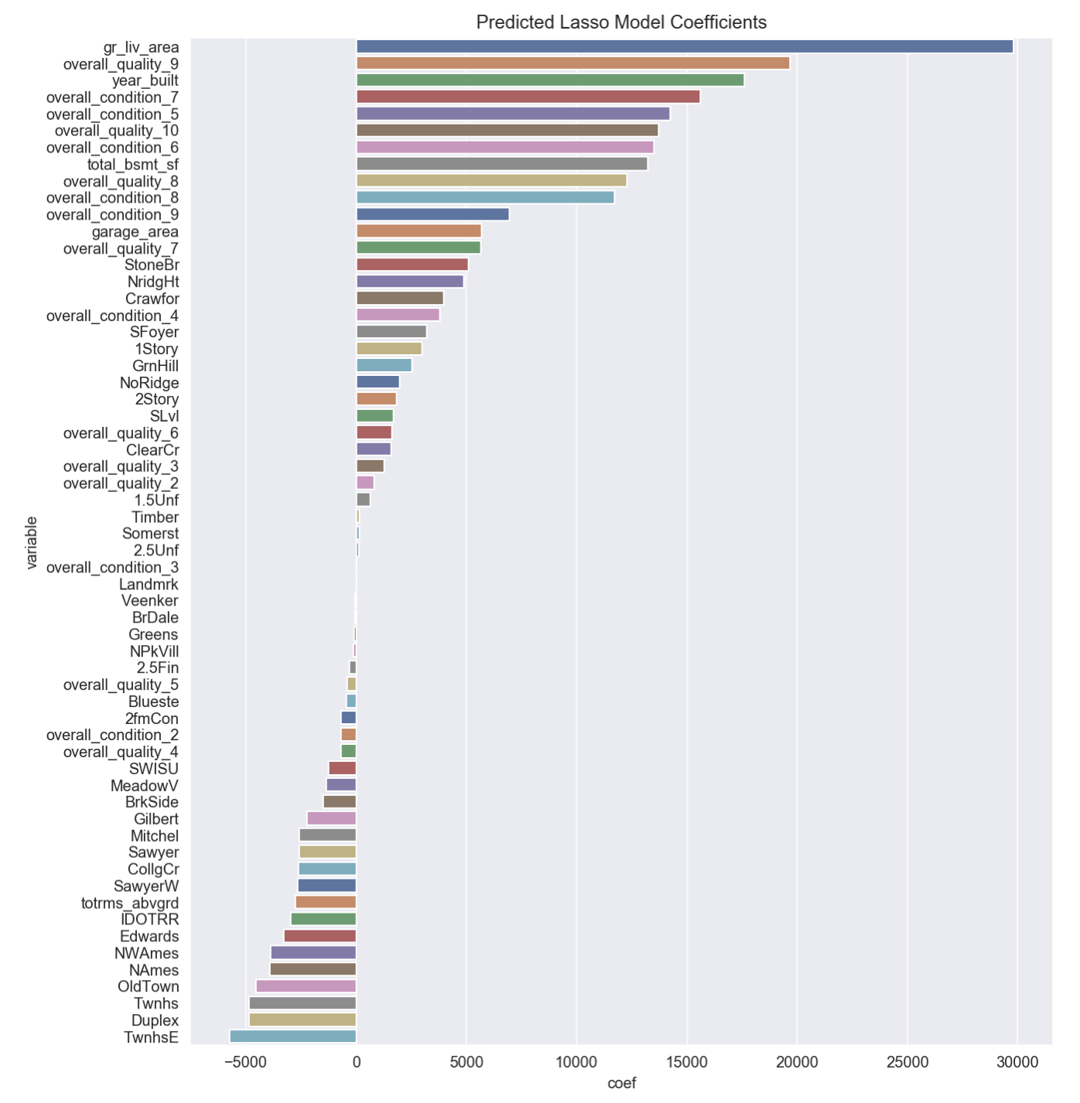
10 key features that add most value to a home
Ground Living Area
Year Built
Overall Condition
Overall Quality
Total Basement Sq ft
Garage Area
Total Rooms
House Style
Neighborhood
Building Type

Slide 10
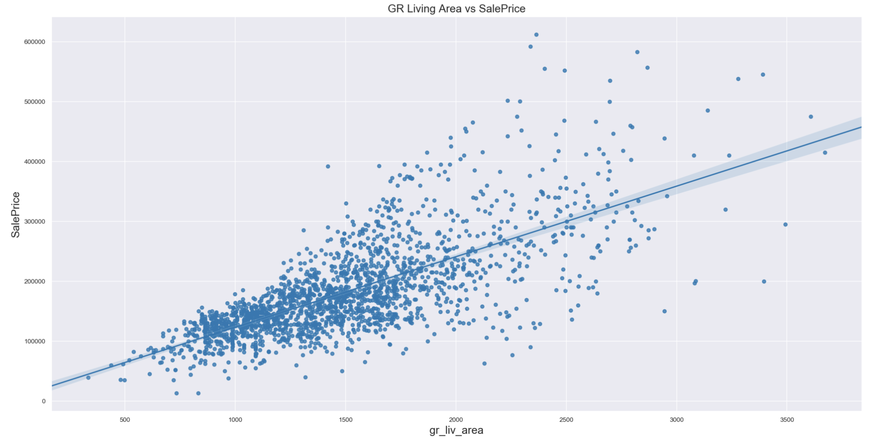
Renovate your house to maximise living space.
The bigger your living area (sq ft), the higher you can expect your sale price to be.

Slide 11
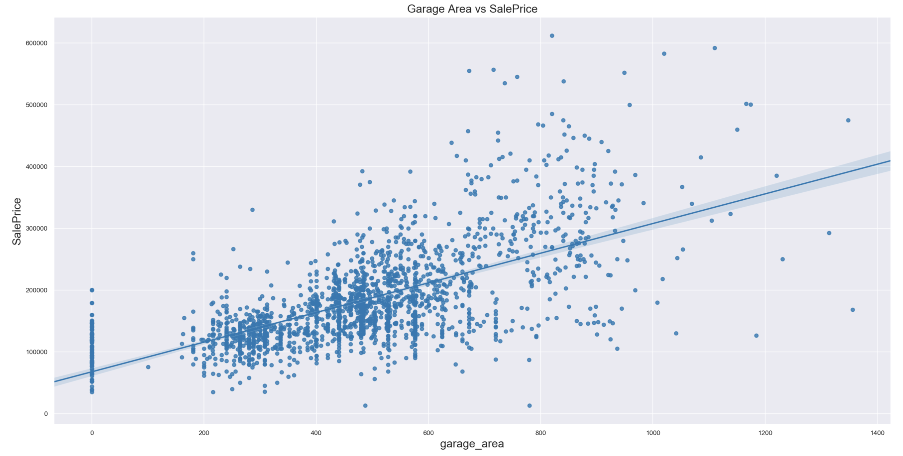
Having a bigger garage improves sale price as well

Slide 12
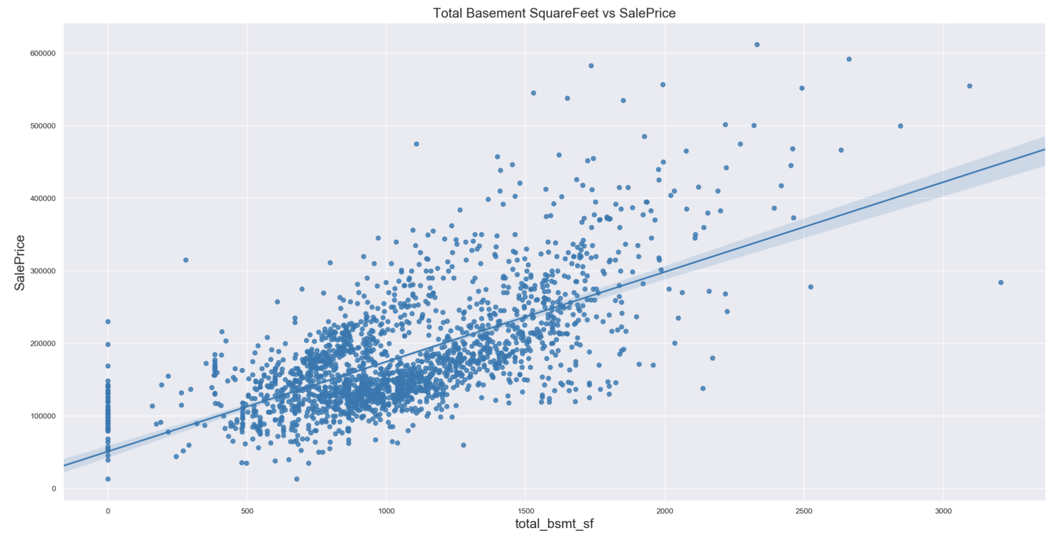
Likewise, a bigger basement area increases sale price as well

Slide 13
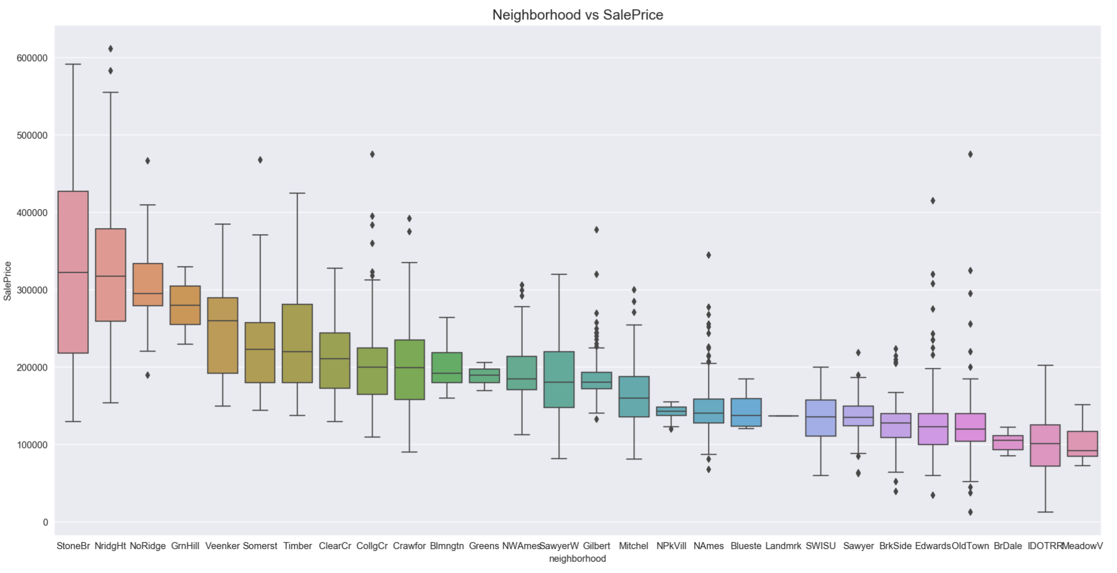
In general, residences in Stone bridge and North ridge heights command a higher price.

Slide 14
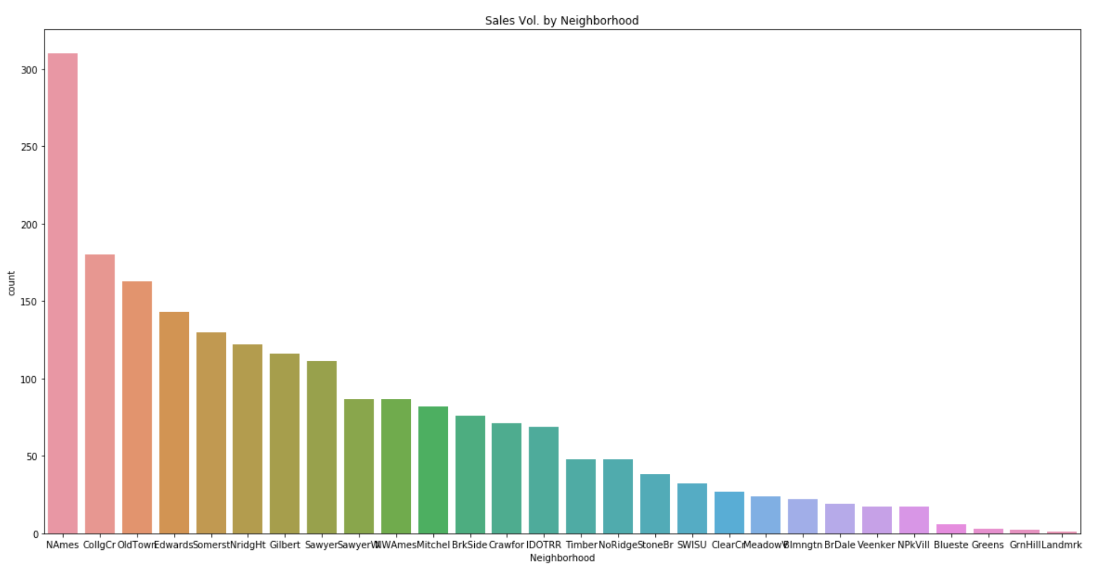
Fun Fact
If you are undecided and risk-averse, you may consider North Ames where the property market seems to be most active!
Blmngtn: Bloomington Heights
Blueste: Bluestem
BrDale: Briardale
BrkSide: Brookside
ClearCr: Clear Creek
CollgCr: College Creek
Crawfor: Crawford
Edwards: Edwards
Gilbert: Gilbert
IDOTRR: Iowa DOT and Rail Road
MeadowV: Meadow Village
Mitchel: Mitchell
Names: North Ames
NoRidge: Northridge
NPkVill: Northpark Villa
NridgHt: Northridge Heights
NWAmes: Northwest Ames
OldTown: Old Town
SWISU: South & West of Iowa State University
Sawyer: Sawyer
SawyerW: Sawyer West
Somerst: Somerset
StoneBr: Stone Brook
Timber: Timberland
Veenker: Veenker

Slide 15
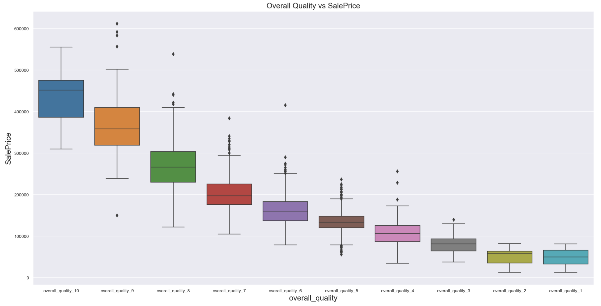
Consider the quality of your home wisely!
Material and finishing of a house has a disproportionate impact on selling price.
10 Very Excellent
9 Excellent
8 Very Good
7 Good
6 Above Average
5 Average
4 Below Average
3 Fair
2 Poor
1 Very Poor

Slide 16

Condition matters too!

Slide 17
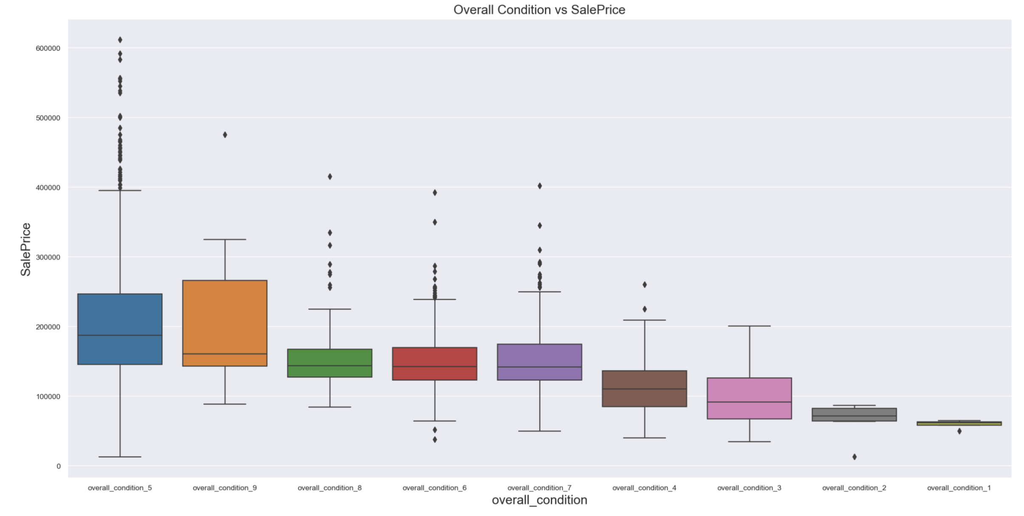
It is possible to fetch a high price for your home that is in fairly good condition. A lot depends on your pitch!
10 Very Excellent
9 Excellent
8 Very Good
7 Good
6 Above Average
5 Average
4 Below Average
3 Fair
2 Poor
1 Very Poor

Slide 18
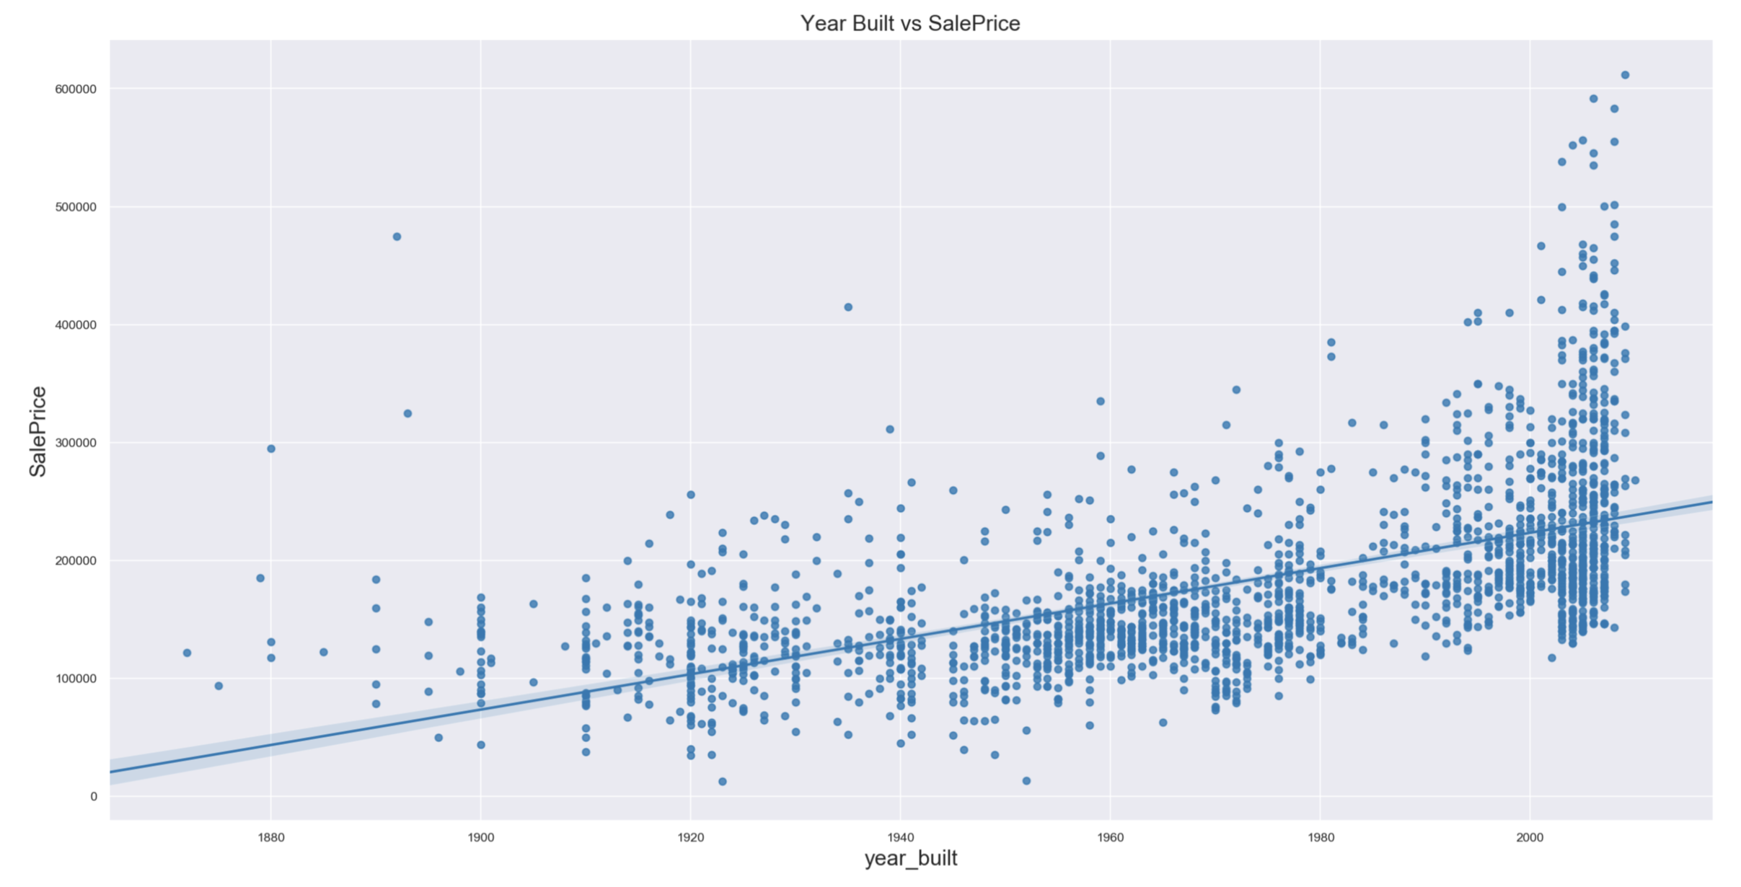
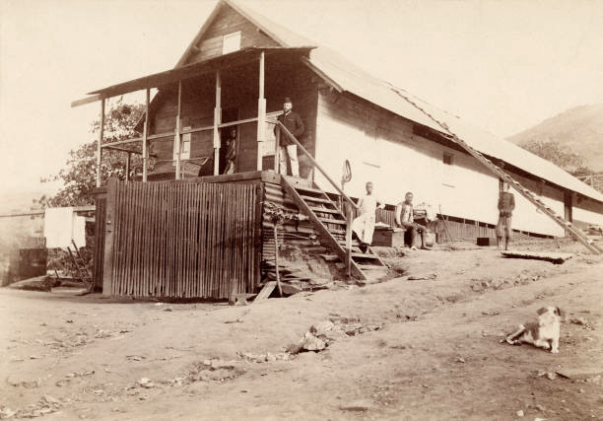
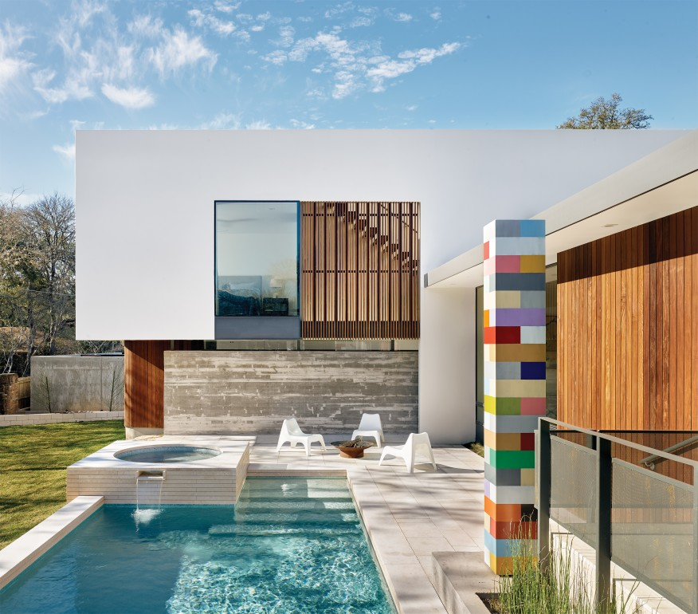
The best time to sell your house is… NOW!
The older the house, the greater the loss on its valuation

Slide 19
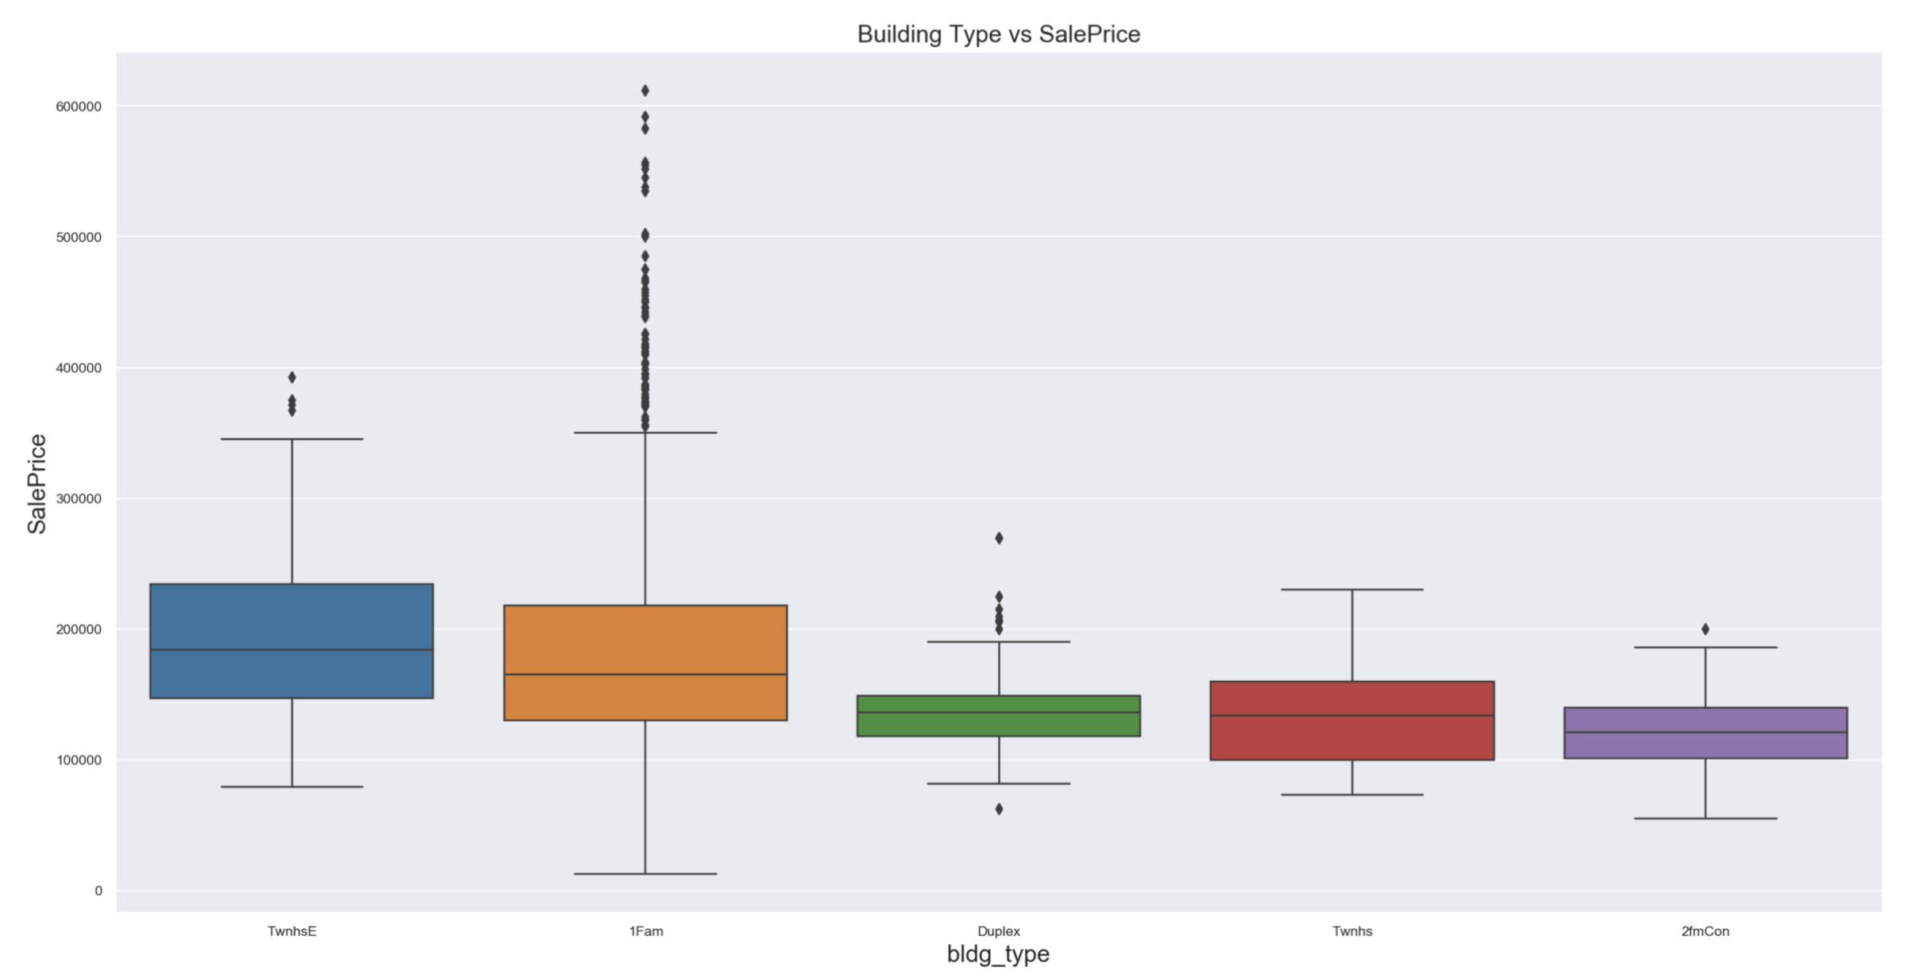
For those with a small family, go for single family detached houses.
The odds to sell off at exorbitant prices are apparent.
TwnhsE :Townhouse End Unit
1Fam : Single-family Detache
Duplx : Duplex
TwnhsI: Townhouse Inside Unit
2FmCon:Two-family Conversion (originally built as one-family dwelling)

Slide 20
Recommendations

Slide 21

How to Maximize Sale Price
New Owners
Existing Owners
Year Built
Housing Condition
Get a newly built house
Perform maintenance works just enough to meet the average condition
Living Area
Housing Quality
Maximise property space (living, basement, garage areas and the number of rooms
Perform renovation / upgrading works to improve the material/finishing of your house
Neighborhood and House/Bldg Type
Reside in Stone Brook or Northridge Heights if possible

Slide 22




Contact Ames Realtor Today!
(special offer to our birthday girl Serene!)
Chun Wai
Elsia
William
Yong Xun
Real Estate Agent
Debt Collector
Exotic Material Supplier
Sub-Contractor

Slide 23

Thank you!

Slide 24

Thank you

Slide 25
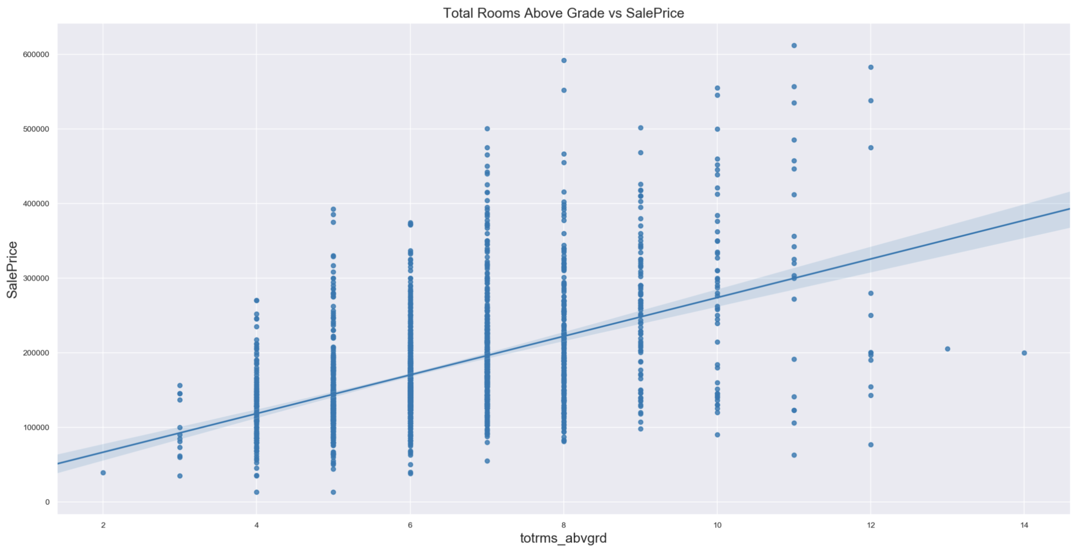
More rooms means higher price
!!! (However it is constrained by above ground living area)
Having 8 - 12 rooms are optimal in increasing sale prices

Slide 26
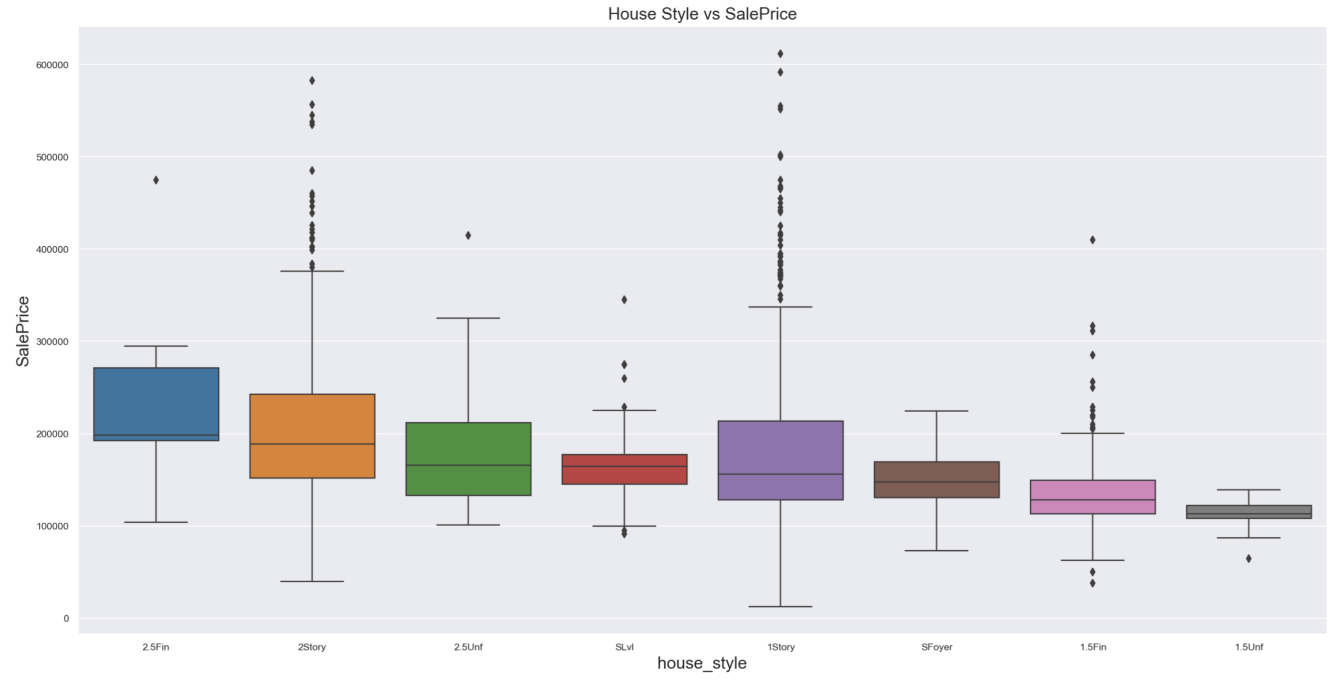
Houses with clearly defined storeys (both 1 and 2 storeys) commands a higher price.

Slide 27
